Slide 1
MARTIN LUTHER KING
A charismatic civil rights leader

Slide 2
How would you describe Martin Luther King?
Martin Luther King was a phenomenal leader and some of the traits that he possessed were intelligence, self-confidence, and determination. As a leader, being intelligent is very important within an organization because a leader is expected to know a lot

Slide 3
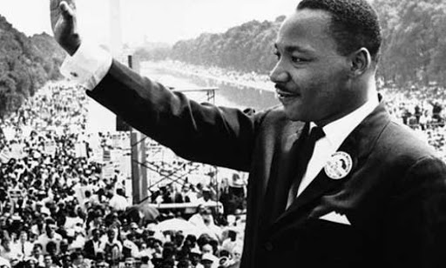

Slide 4
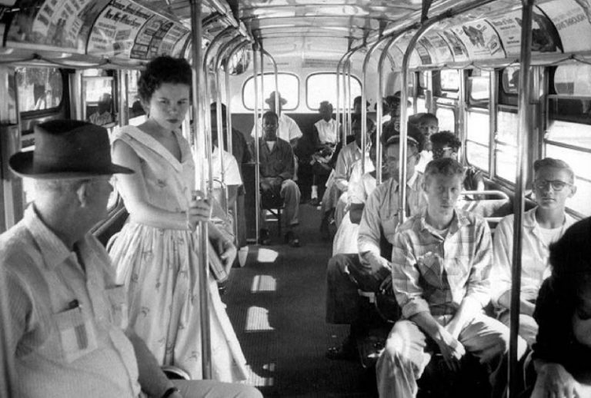
African Americans in the 1950s couldn’t go to the same schools as white Americans. On buses and trains, they had to sit in a different section from white passengers. African Americans had to go to different hospitals and shops and they couldn’t eat in the same restaurants AS white Americans. The law at the time said African Americans were ‘separate but equal’ – so they had to live separate lives from white AmericanS.

Slide 5
What did Martin Luther King do?
Martin Luther King, was an activist and pastor who promoted and organized non-violent protests. The Civil Rights Movement wanted African Americans to have the same right to freedom and equality as white Americans. Martin Luther King believed in non-violent protest and he organised many campaigns against racial discrimination. The police frequently arrested him and sent him to prison, but he continued to protest.In 1963, there was an important civil rights protest in Washington.

Slide 6
Martin Luther King spoke to the people about his dream for the future: freedom and equality for all Americans. He began with the words: ‘I have a dream’. His speech is famous all over the world.

Slide 7
100% naturali Realizzati nella ridente baia di California.

Slide 8
“I Have A Dream” is an unforgettable speech delivered by Martin Luther King to millions of American blacks and whites on August 28, 1963. This speech represents the hopes and dreams of all American blacks.

Slide 9
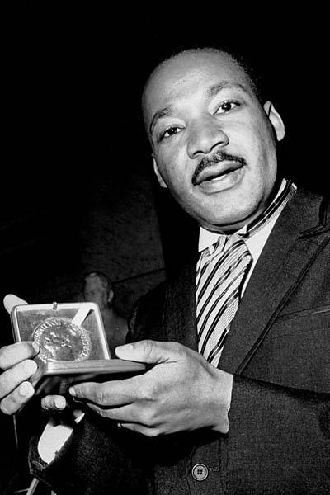
NOBEL PRIZE
In 1964, he won the Nobel Prize for Peace and in 1965, the American government finally made it possible for all African Americans to vote.

Slide 10
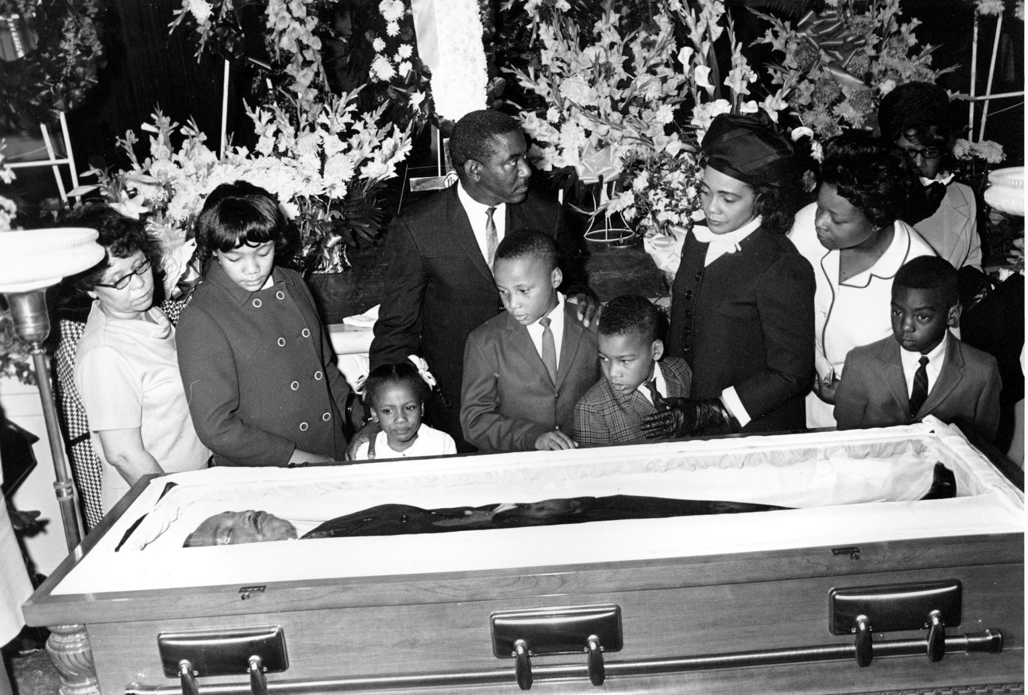
Martin Luther King was assassinated in Memphis, Tennessee, in April 1968, but in July 1968 the American Government passed the Civil Rights Act and finally African Americans had the same rights as white Americans.

